Slide 1
Chapter 14: Indexing

Slide 2
Outline
Basic Concepts
Ordered Indices
B⁺-Tree Index
B+-Tree File Organization
B-Tree Index Files
Indices on Multiple Keys
Indexing on Flash
Indexing in Main Memory
Write Optimized Indices
  Log Structured Merge (LSM) Tree
  Buffer Tree
Bitmap Indices

Slide 3
Basic Concepts
Indexing mechanisms used to speed up access to desired data.
  E.g., author catalog in library
Search Key - attribute to set of attributes used to look up records in a file.
An index file consists of records (called index entries) of the form
Index files are typically much smaller than the original file
Two basic kinds of indices:
  Ordered indices: search keys are stored in sorted order
  Hash indices: search keys are distributed uniformly across “buckets” using a “hash function”.
search-key
pointer

Slide 4
Index Evaluation Metrics
Access types supported efficiently. E.g.,
  Point query: records with a specified value in the attribute
  Range query: or records with an attribute value falling in a specified range of values.
Access time
Insertion time
Deletion time
Space overhead

Slide 5
Ordered Indices
In an ordered index, index entries are stored sorted on the search key value. E.g., author catalog in library.
Primary index（主索引）: in a sequentially ordered file, the index whose search key specifies the sequential order of the file.
  Also called clustering index（聚集索引）
  The search key of a primary index is usually but not necessarily the primary key.
Secondary index（辅助索引）: an index whose search key specifies an order different from the sequential order of the file. Also called
non-clustering index.
Index-sequential file（索引顺序文件）: ordered sequential file with a primary index.

Slide 6

Primary index（主索引）
primary index on ID attribute of instructor

Slide 7

Secondary Indices Example
Secondary index on salary attribute of instructor

Slide 8
Dense Index Files
Dense index(稠密索引) — Index record appears for every search-key value in the file.
E.g. index on ID attribute of instructor relation

Slide 9

Dense Index Files (Cont.)
Dense index on dept_name, with instructor file sorted on dept_name

Slide 10

Sparse Index Files
Sparse Index（稀疏索引）: contains index records for only some search-key values.
  Applicable when records are sequentially ordered on search-key
To locate a record with search-key value K we:
  Find index record with largest search-key value < K
  Search file sequentially starting at the record to which the index record points

Slide 11

Sparse Index Files (Cont.)
Compared to dense indices:
  Less space and less maintenance overhead for insertions and deletions.
  Generally slower than dense index for locating records.
Good tradeoff: sparse index with an index entry for every block in file, corresponding to least search-key value in the block.

Slide 12
Multilevel Index（多级索引）
If primary index does not fit in memory, access becomes expensive.
Solution: treat primary index kept on disk as a sequential file and construct a sparse index on it.
  outer index – a sparse index of primary index
  inner index – the primary index file
If even outer index is too large to fit in main memory, yet another level of index can be created, and so on.
Indices at all levels must be updated on insertion or deletion from the file.

Slide 13
B⁺-Tree Index Files
B⁺-tree index files are an alternative to indexed-sequential files.
Disadvantage of indexed-sequential files
  performance degrades as file grows, since many overflow blocks get created.
  Periodic reorganization of entire file is required.
Advantage of B⁺-tree index files:
  automatically reorganizes itself with small, local, changes, in the face of insertions and deletions.
  Reorganization of entire file is not required to maintain performance.
(Minor) disadvantage of B⁺-trees:
  extra insertion and deletion overhead, space overhead.
Advantages of B⁺-trees outweigh disadvantages
  B⁺-trees are used extensively

Slide 14

B⁺-Tree Index
A B⁺-tree is a rooted tree satisfying the following properties:
All paths from root to leaf are of the same length
Inner node(not a root or a leaf): between ⎡n/2⎤ and n children.
Leaf node: between ⎡(n–1)/2⎤ and n–1 values
Special cases:
  If the root is not a leaf:
  at least 2 children.
  If the root is a leaf :
  between 0 and (n–1)values.

Slide 15
B⁺-Tree Node Structure
Typical node
  K_{i} are the search-key values
  P_{i} are pointers to children (for non-leaf nodes) or pointers to records or buckets of records (for leaf nodes).
The search-keys in a node are ordered
K₁ < K₂ < K₃ < . . . < K_{n–1}

Slide 16

Leaf Nodes in B⁺-Trees
Properties of a leaf node:
For i = 1, 2, . . ., n–1, pointer P_{i} points to a file record with search-key value K_{i},
If L_{i}, L_{j} are leaf nodes and i < j, L_{i}’s search-key values are less than or equal to L_{j}’s search-key values
P_{n} points to next leaf node in search-key order

Slide 17
Non-Leaf Nodes in B⁺-Trees
Non leaf nodes form a multi-level sparse index on the leaf nodes.
For a non-leaf node with m pointers:
  P₁ : all the search-keys in the subtree to which P₁ points are less than K₁
  P_{i} (2 ≤ i ≤ n – 1): all the search-keys in the subtree to which P_{i} points have values greater than or equal to K_{i–1} and less than K_{i}
  P_{n} : All the search-keys in the subtree to which P_{n} points have values greater than or equal to K_{n–1}

Slide 18

Example of B⁺-tree
B⁺-tree for instructor file (n = 6)
Leaf nodes must have between 3 and 5 values
(⎡(n–1)/2⎤ and n –1, with n = 6).
Non-leaf nodes other than root must have between 3 and 6 children (⎡(n/2⎤ and n with n =6).
Root must have at least 2 children.

Slide 19
Observations about B⁺-trees
Since the inter-node connections are done by pointers, “logically” close blocks need not be “physically” close.
The non-leaf levels of the B⁺-tree form a hierarchy of sparse indices.
The B⁺-tree contains a relatively small number of levels
    Level below root has at least 2* ⎡n/2⎤ values
    Next level has at least 2* ⎡n/2⎤ * ⎡n/2⎤ values
    .. etc.
  If there are K search-key values in the file, the tree height is no more than ⎡ log_{⎡n/2⎤}(K)⎤ ~ ⎡ log_{⎡n/2⎤}(K/2)⎤ +1
  thus searches can be conducted efficiently.
Insertions and deletions to the main file can be handled efficiently, as the index can be restructured in logarithmic time .

Slide 20

Query on B⁺-Tree
function find(v) // Find record with search-key value V
  C=root
  While C is not a leaf node {
    Let i be least value s.t. V ≤ K_{i}.
    If no such exists, set C = last non-null pointer in C
    Else { if (V= K_{i} ) Set C = P_{i +1} else set C = P_{i}}
    }
  Let i be least value s.t. K_{i} = V
  If there is such a value i, follow pointer P_{i} to the desired record.
  Else no record with search-key value k exists.

Slide 21
Query on B⁺⁻Tree(Cont.)
If there are K search-key values in the file, the height of the tree is no more than ⎡log_{⎡n/2⎤}(K)⎤.
A node is generally the same size as a disk block, typically 4 kilobytes
  and n is typically around 100 (40 bytes per index entry).
With 1 million search key values and n = 100
  at most log₅₀(1,000,000) = 4 nodes are accessed in a lookup.
Contrast this with a balanced binary tree with 1 million search key values — around 20 nodes are accessed in a lookup
  above difference is significant since every node access may need a disk I/O, costing around 20 milliseconds

Slide 22
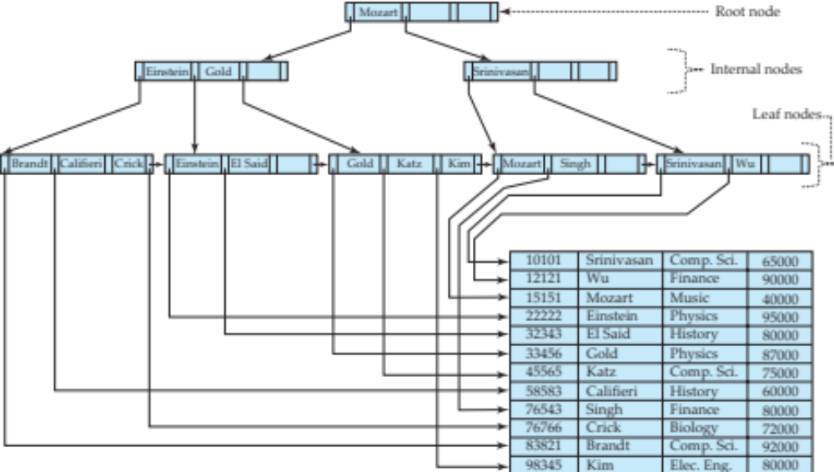
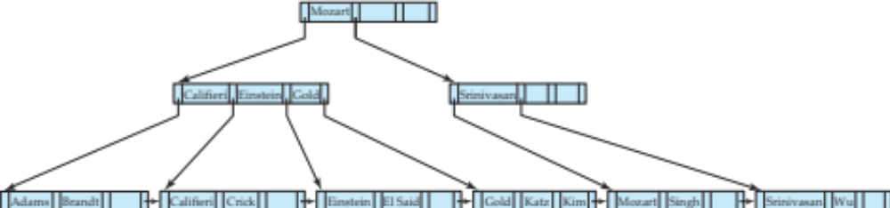
Examples of Insert on B⁺-Tree
Affected nodes:
B⁺-Tree before and after insertion of “Adams”

Slide 23
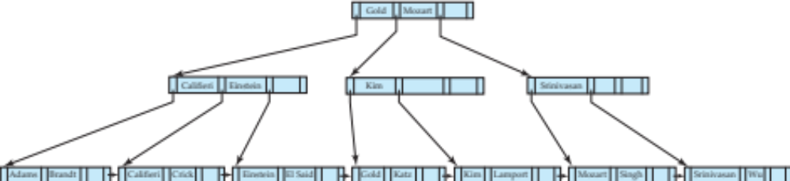
Examples of Insert on B⁺-Tree
B⁺-Tree before and after insertion of “Lamport”

Slide 24
Insert on B⁺-Trees
function insert (pr, v)
/* Assume record already added to the file. Let
  pr be pointer to the record, and let
  v be the search key value of the record */
Find the leaf node in which the search-key value would appear
  If there is room in the leaf node, insert (v, pr) pair in the leaf node
  Otherwise, split the node (along with the new (v, pr) entry) as discussed in the next slide, and propagate updates to parent nodes.

Slide 25
Insert on B⁺-Trees (Cont.)
Splitting a leaf node:
  take the n (search-key value, pointer) pairs (including the one being inserted) in sorted order. Place the first ⎡n/2⎤ in the original node, and the rest in a new node.
  let the new node be p, and let k be the least key value in p. Insert (k,p) in the parent of the node being split.
  If the parent is full, split it and propagate the split further up.
Splitting of nodes proceeds upwards till a node that is not full is found.
  In the worst case the root node may be split increasing the height of the tree by 1.
Result of splitting node containing Brandt, Califieri and Crick on inserting Adams
Next step: insert entry with (Califieri, pointer-to-new-node) into parent

Slide 26
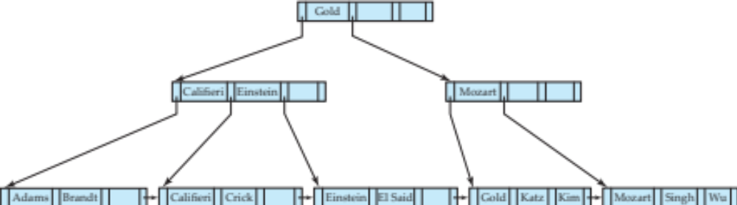
Examples of Delete on B⁺-Tree
Before and after deleting “Srinivasan”
Deleting “Srinivasan” causes merging of under-full leaves

Slide 27
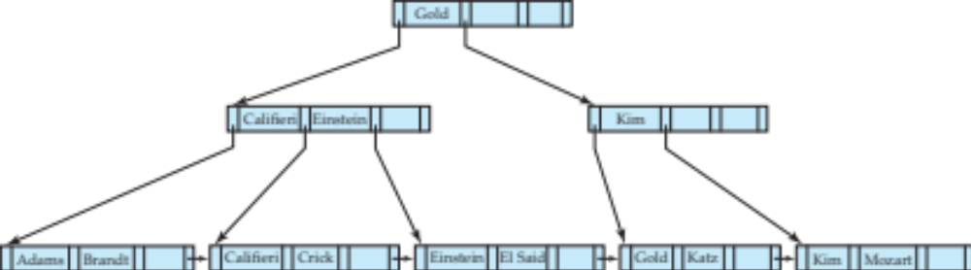
Examples of Delete on B⁺-Tree (Cont.)
Before and after deleting “Singh” and “Wu”
Leaf containing Singh and Wu became underfull, and borrowed a value Kim from its left sibling
Search-key value in the parent changes as a result

Slide 28
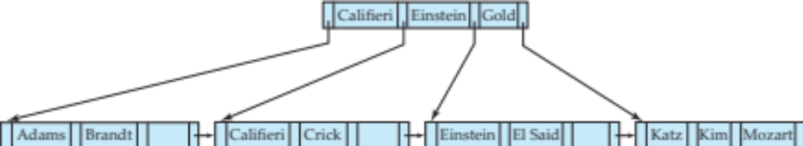
Example of Delete on B⁺-tree (Cont.)
Before and after deletion of “Gold”
Node with Gold and Katz became underfull, and was merged with its sibling
Parent node becomes underfull, and is merged with its sibling
  Value separating two nodes (at the parent) is pulled down when merging
Root node then has only one child, and is deleted

Slide 29
Delete on B⁺-Tree
Function delete(pr, v)
/*Assume record already deleted from file. Let v be the search key value of the record, and pr be the pointer to the record. */
Remove (pr, v) from the leaf node
If the node has too few entries due to the removal, and the entries in the node and a sibling fit into a single node, then merge siblings:
  Insert all the search-key values in the two nodes into a single node (the one on the left), and delete the other node.
  Delete the pair (K_{i–1}, P_{i}), where P_{i} is the pointer to the deleted node, from its parent, recursively using the above procedure.

Slide 30
Delete on B⁺-Tree(Cont.)
Otherwise, if the node has too few entries due to the removal, but the entries in the node and a sibling do not fit into a single node, then redistribute pointers:
  Redistribute the pointers between the node and a sibling such that both have more than the minimum number of entries.
  Update the corresponding search-key value in the parent of the node.
The node deletions may cascade upwards till a node which has ⎡n/2⎤ or more pointers is found.
If the root node has only one pointer after deletion, it is deleted and the sole child becomes the root.

Slide 31
Complexity of Updates
Cost (in terms of number of I/O operations) of insertion and deletion of a single entry proportional to height of the tree
  With K entries and maximum fanout of n, worst case complexity of insert/delete of an entry is O(log_{⎡n/2⎤}(K))
In practice, number of I/O operations is less:
  Internal nodes tend to be in buffer
  Splits/merges are rare, most insert/delete operations only affect a leaf node
Average node occupancy depends on insertion order
  2/3 with random, ½ with insertion in sorted order

Slide 32
Non-Unique Search Keys
If a search key a_{i} is not unique, create instead an index on a composite key (a_{i} , A_{p}), which is unique
  A_{p} could be a primary key, record ID, or any other attribute that guarantees uniqueness
Search for a_{i} = v can be implemented by a range search on composite key, with range (v, - ∞) to (v, + ∞)
Extra storage overhead for keys
Simpler code for insertion/deletion
More I/O operations are needed to fetch the actual records
  If the index is clustering, all accesses are sequential
  If the index is non-clustering, each record access may need an I/O operation
  Widely used

Slide 33
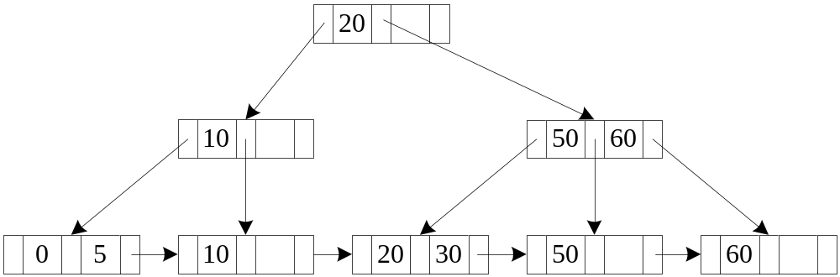
Example of B+ -Tree
0------
5------
10------
20------
30------
50------
。。。
60------

Slide 34
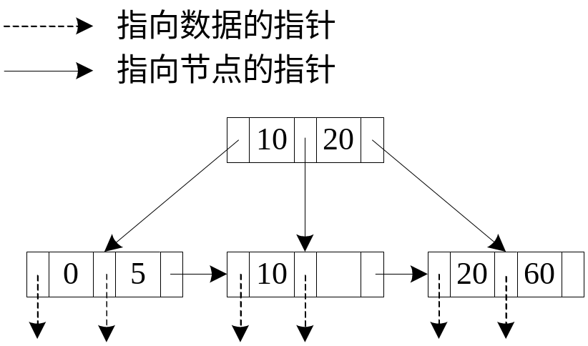
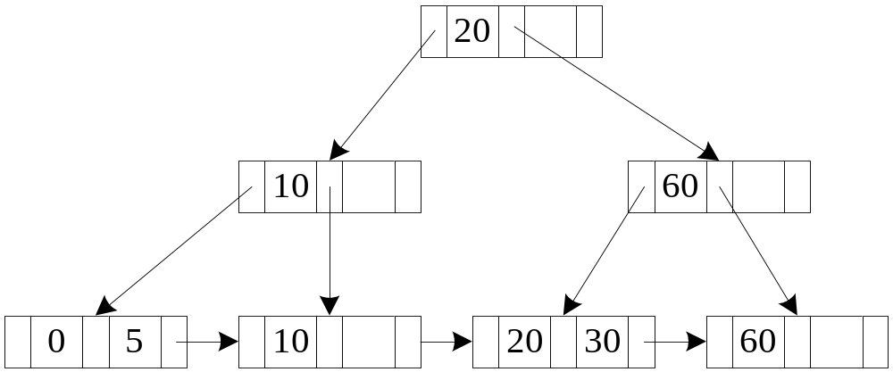
Example of B+- Tree: insert 30

Slide 35
Example of B+- Tree: insert 50

Slide 36
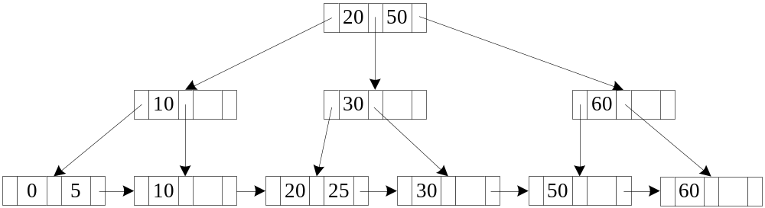
Example of B+- Tree: insert 25

Slide 37
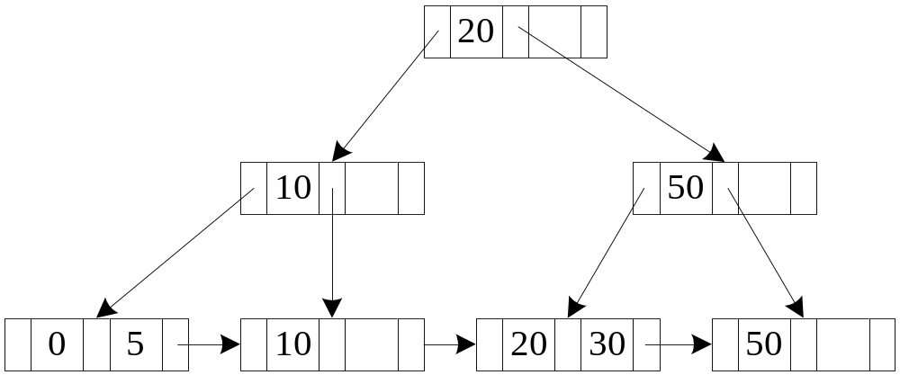
Example of B+- Tree: delete 60

Slide 38
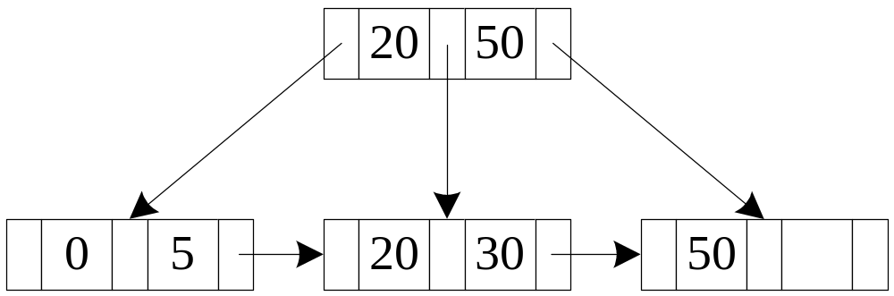
Example of B+- Tree: delete 10

Slide 39
B+- tree : height and size estimation
person( pid char(18) primary key，
name char(8),
age smallint,
address char(40) );
block size : 4K
1000000 persons
person record size = 18+8+2+40 = 68
Records per block = 4096/68= 60.235 → 60
blocks for storing 1M persons= ⎡ 1000000/60 ⎤ =16667
B+ tree n(fan-out) = (4096-4)/(18+4) +1 = 187
⎡n/2⎤ = 94 , inner pointers : 94~187
⎡n-1/2⎤ =93, leaf values : 93~186
2 levels: min=2*93 =186 max= 187*186= 34,782
3 levels: min=2*94*93 =17484 max= 187*187*186=6,504,234
4 levels: min=2*94*94*93=1,643,496 max= 187*187*187*186= 1,216,291,758

Slide 40
Estimating height & size of B+-tree
person( pid char(18), name char(8), age smallint,
address char(40), primary key (pid));
Block size : 4K
1000000 persons B+ tree size estimation.xlsx
2.641029 | <= | B+ level | <= | 3.8883
3 | <= | B+ level | <= | 3
 |  | half full leaf nodes
 |  | leaf level nodes |  |  | 10752.69 | 10752 | nodes
 |  | second level nodes |  |  |  | 114 | nodes
 |  | root |  |  |  | 1 | node
 |  | total nodes |  |  |  | 10867
 |  | full leaf nodes
 |  | leaf level nodes |  |  | 5376.344 | 5377 | nodes
 |  | second level nodes |  |  |  | 29 | nodes
 |  | root |  |  |  | 1 | node
 |  | total nodes |  |  |  | 5407
max
min

Slide 41
B⁺-Tree File Organization
B+-Tree File Organization:
  Leaf nodes in a B+-tree file organization store records, instead of pointers
  Helps keep data records clustered even when there are insertions/deletions/updates
Leaf nodes are still required to be half full
  Since records are larger than pointers, the maximum number of records that can be stored in a leaf node is less than the number of pointers in a nonleaf node.
Insertion and deletion are handled in the same way as insertion and deletion of entries in a B⁺-tree index.

Slide 42
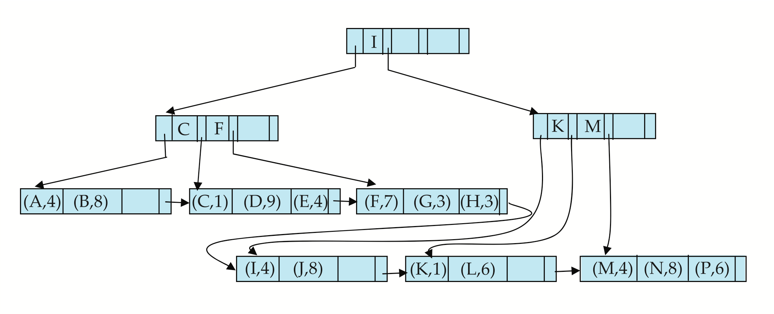

B⁺-Tree File Organization (Cont.)
Example of B⁺-tree File Organization
Good space utilization important since records use more space than pointers.
To improve space utilization, involve more sibling nodes in redistribution during splits and merges
  Involving 2 siblings in redistribution (to avoid split / merge where possible) results in each node having at least entries

Slide 43
Other Issues in Indexing
Record relocation and secondary indices
  If a record moves, all secondary indices that store record pointers have to be updated
  Node splits in B⁺-tree file organizations become very expensive
  Solution: use primary-index search key instead of record pointer in secondary index
    Extra traversal of primary index to locate record
      Higher cost for queries, but node splits are cheap
    Add record-id if primary-index search key is non-unique

Slide 44
Indexing Strings
Variable length strings as keys
  Variable fanout
  Use space utilization as criterion for splitting, not number of pointers
Prefix compression
  Key values at internal nodes can be prefixes of full key
    Keep enough characters to distinguish entries in the subtrees separated by the key value
      E.g. “Silas” and “Silberschatz” can be separated by “Silb”
  Keys in leaf node can be compressed by sharing common prefixes

Slide 45
Bulk Loading and Bottom-Up Build
Inserting entries one-at-a-time into a B⁺-tree requires ≥ 1 IO per entry
  assuming leaf level does not fit in memory
  can be very inefficient for loading a large number of entries at a time (bulk loading)
Efficient alternative 1: Insert in sorted order
  sort entries first (using efficient external-memory sort algorithms）
  insert in sorted order
    insertion will go to existing page (or cause a split)
    much improved IO performance, but most leaf nodes half full
Efficient alternative 2: Bottom-up B⁺-tree construction
  As before sort entries
  And then create tree layer-by-layer, starting with leaf level
  Implemented as part of bulk-load utility by most database systems

Slide 46
Bottom-Up B+-tree Build
Bottom-up B+-tree construction
  First sort index entries
  Then create B+-tree layer-by-layer, starting with leaf level
  The built B+-tree is written to disk using sequential I/O operations
  Example : build a B+-tree for the following 16 entries, assuming the fan-out(n) of the B+-tree is 4:
  (23 25 27 29 1 5 7 9 11 31 37 41 45 15 17 19)
  → ( 1 5 7 9 11 15 17 19 23 25 27 29 31 37 41 45)
  Estimated cost :
  1 seek + 9 block transfers
41
9 17 25
41
1 5 7
9 11 15
17 1 9 2 3
25 27 29
31 37
41 45

Slide 47
Bottom-Up B+-tree Build
  Bulk insert index entries
  Build a new B+-tree using the Bottom-UP Build algorithm
  Example: insert following 9 entries into previous B+-tree
  (21 33 35 39 43 47 49 3 13)
  →( 3 13 21 33 35 39 43 47 49)
  Estimated cost :
  2 seeks + 19 block transfers
13 25
7 13 19
31 37
25 28
1 3 5
7 9 11
13 15 17
19 21 23
25 27 29
31 33 35
37 39 41
43 45
47 49
  Merge two existing two B+-trees , to create a new B+-tree using the Bottom-UP Build algorithm ，as in LSM-tree Index.

Slide 48
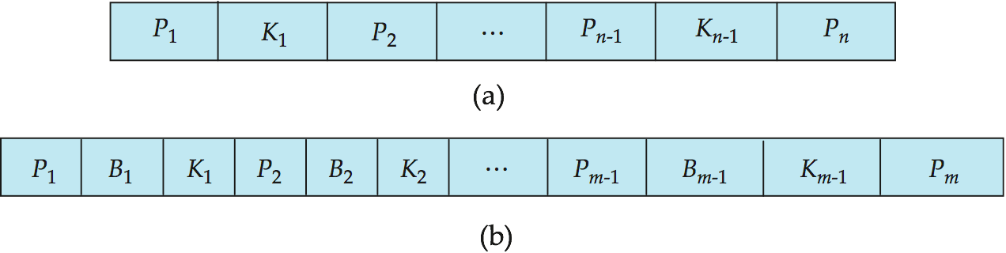
B-Tree Index Files
Similar to B+-tree, but B-tree allows search-key values to appear only once; eliminates redundant storage of search keys.
Search keys in nonleaf nodes appear nowhere else in the B-tree; an additional pointer field for each search key in a nonleaf node must be included.
Generalized B-tree leaf node
Nonleaf node – pointers Bi are the bucket or file record pointers.

Slide 49
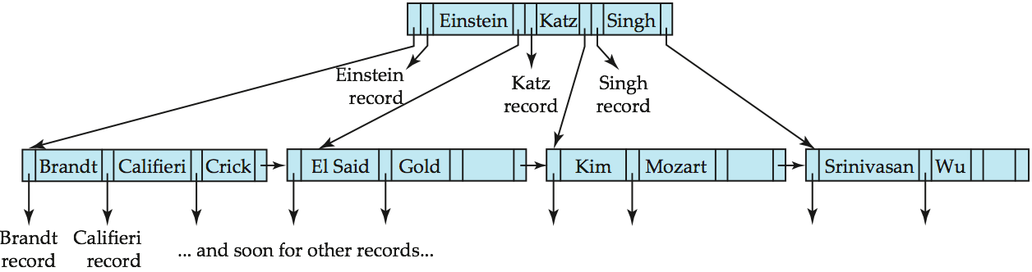
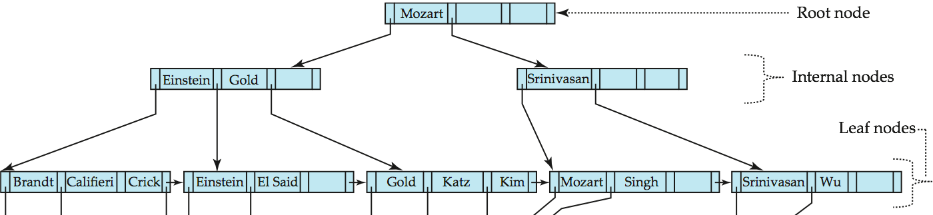
B-Tree Index File Example
B-tree (above) and B+-tree (below) on same data

Slide 50
B-Tree Index Files (Cont.)
Advantages of B-Tree indices:
  May use less tree nodes than a corresponding B⁺-Tree.
  Sometimes possible to find search-key value before reaching leaf node.
Disadvantages of B-Tree indices:
  Only small fraction of all search-key values are found early
  Non-leaf nodes are larger, so fan-out is reduced. Thus, B-Trees typically have greater depth than corresponding B⁺-Tree
  Insertion and deletion more complicated than in B⁺-Trees
  Implementation is harder than B⁺-Trees.
Typically, advantages of B-Trees do not out weigh disadvantages.

Slide 51
Multiple-Key Access
Use multiple indices for certain types of queries.
Example:
  select ID
  from instructor
  where dept_name = “Finance” and salary = 80000
Possible strategies for processing query using indices on single attributes:
  1. Use index on dept_name to find instructors with department name Finance; test salary = 80000
  2. Use index on salary to find instructors with a salary of $80000; test dept_name = “Finance”.
  3. Use dept_name index to find pointers to all records pertaining to the “Finance” department. Similarly use index on salary. Take intersection of both sets of pointers obtained.

Slide 52
Indices on Multiple Keys
Composite search keys are search keys containing more than one attribute
  E.g. (dept_name, salary)
Lexicographic ordering: (a₁, a₂) < (b₁, b₂) if either
  a₁ < b₁, or
  a₁=b₁ and a₂ < b₂

Slide 53
Indices on Multiple Keys
Suppose we have an index on combined search-key
(dept_name, salary).
With the where clause
where dept_name = “Finance” and salary = 80000
the index on (dept_name, salary) can be used to fetch only records that satisfy both conditions.
  Using separate indices in less efficient — we may fetch many records (or pointers) that satisfy only one of the conditions.
Can also efficiently handle
where dept_name = “Finance” and salary < 80000
But cannot efficiently handle
where dept_name < “Finance” and balance = 80000
  May fetch many records that satisfy the first but not the second condition

Slide 54
Indexing in Main Memory
Random access in memory
  Much cheaper than on disk/flash, but still expensive compared to cache read
  Binary search for a key value within a large B⁺-tree node results in many cache misses
  Data structures that make best use of cache preferable – cache conscious
B⁺- trees with small nodes that fit in cache line are preferable to reduce cache misses
Key idea:
  use large node size to optimize disk access,
  but structure data within a node using a tree with small node size, instead of using an array, to optimize cache access.
64B
64B
64B
64B
64B
64B
64B
64B

Slide 55
Indexing on Flash
Random I/O cost much lower on flash
  20 to 100 microseconds for read/write
Writes are not in-place, and (eventually) require a more expensive erase
Optimum page size therefore much smaller
Bulk-loading still useful since it minimizes page erases
Write-optimized tree structures (i.e., LSM-tree) have been adapted to minimize page writes for flash-optimized search trees

Slide 56
Write Optimized Indices
Performance of B⁺-trees can be poor for write-intensive workloads
  One I/O per leaf, assuming all internal nodes are in memory
  With magnetic disks, < 100 inserts per second per disk
  With flash memory, one page overwrite per insert
Two approaches to reducing cost of writes
  Log-structured merge tree (LSM-tree)
  Buffer tree

Slide 57
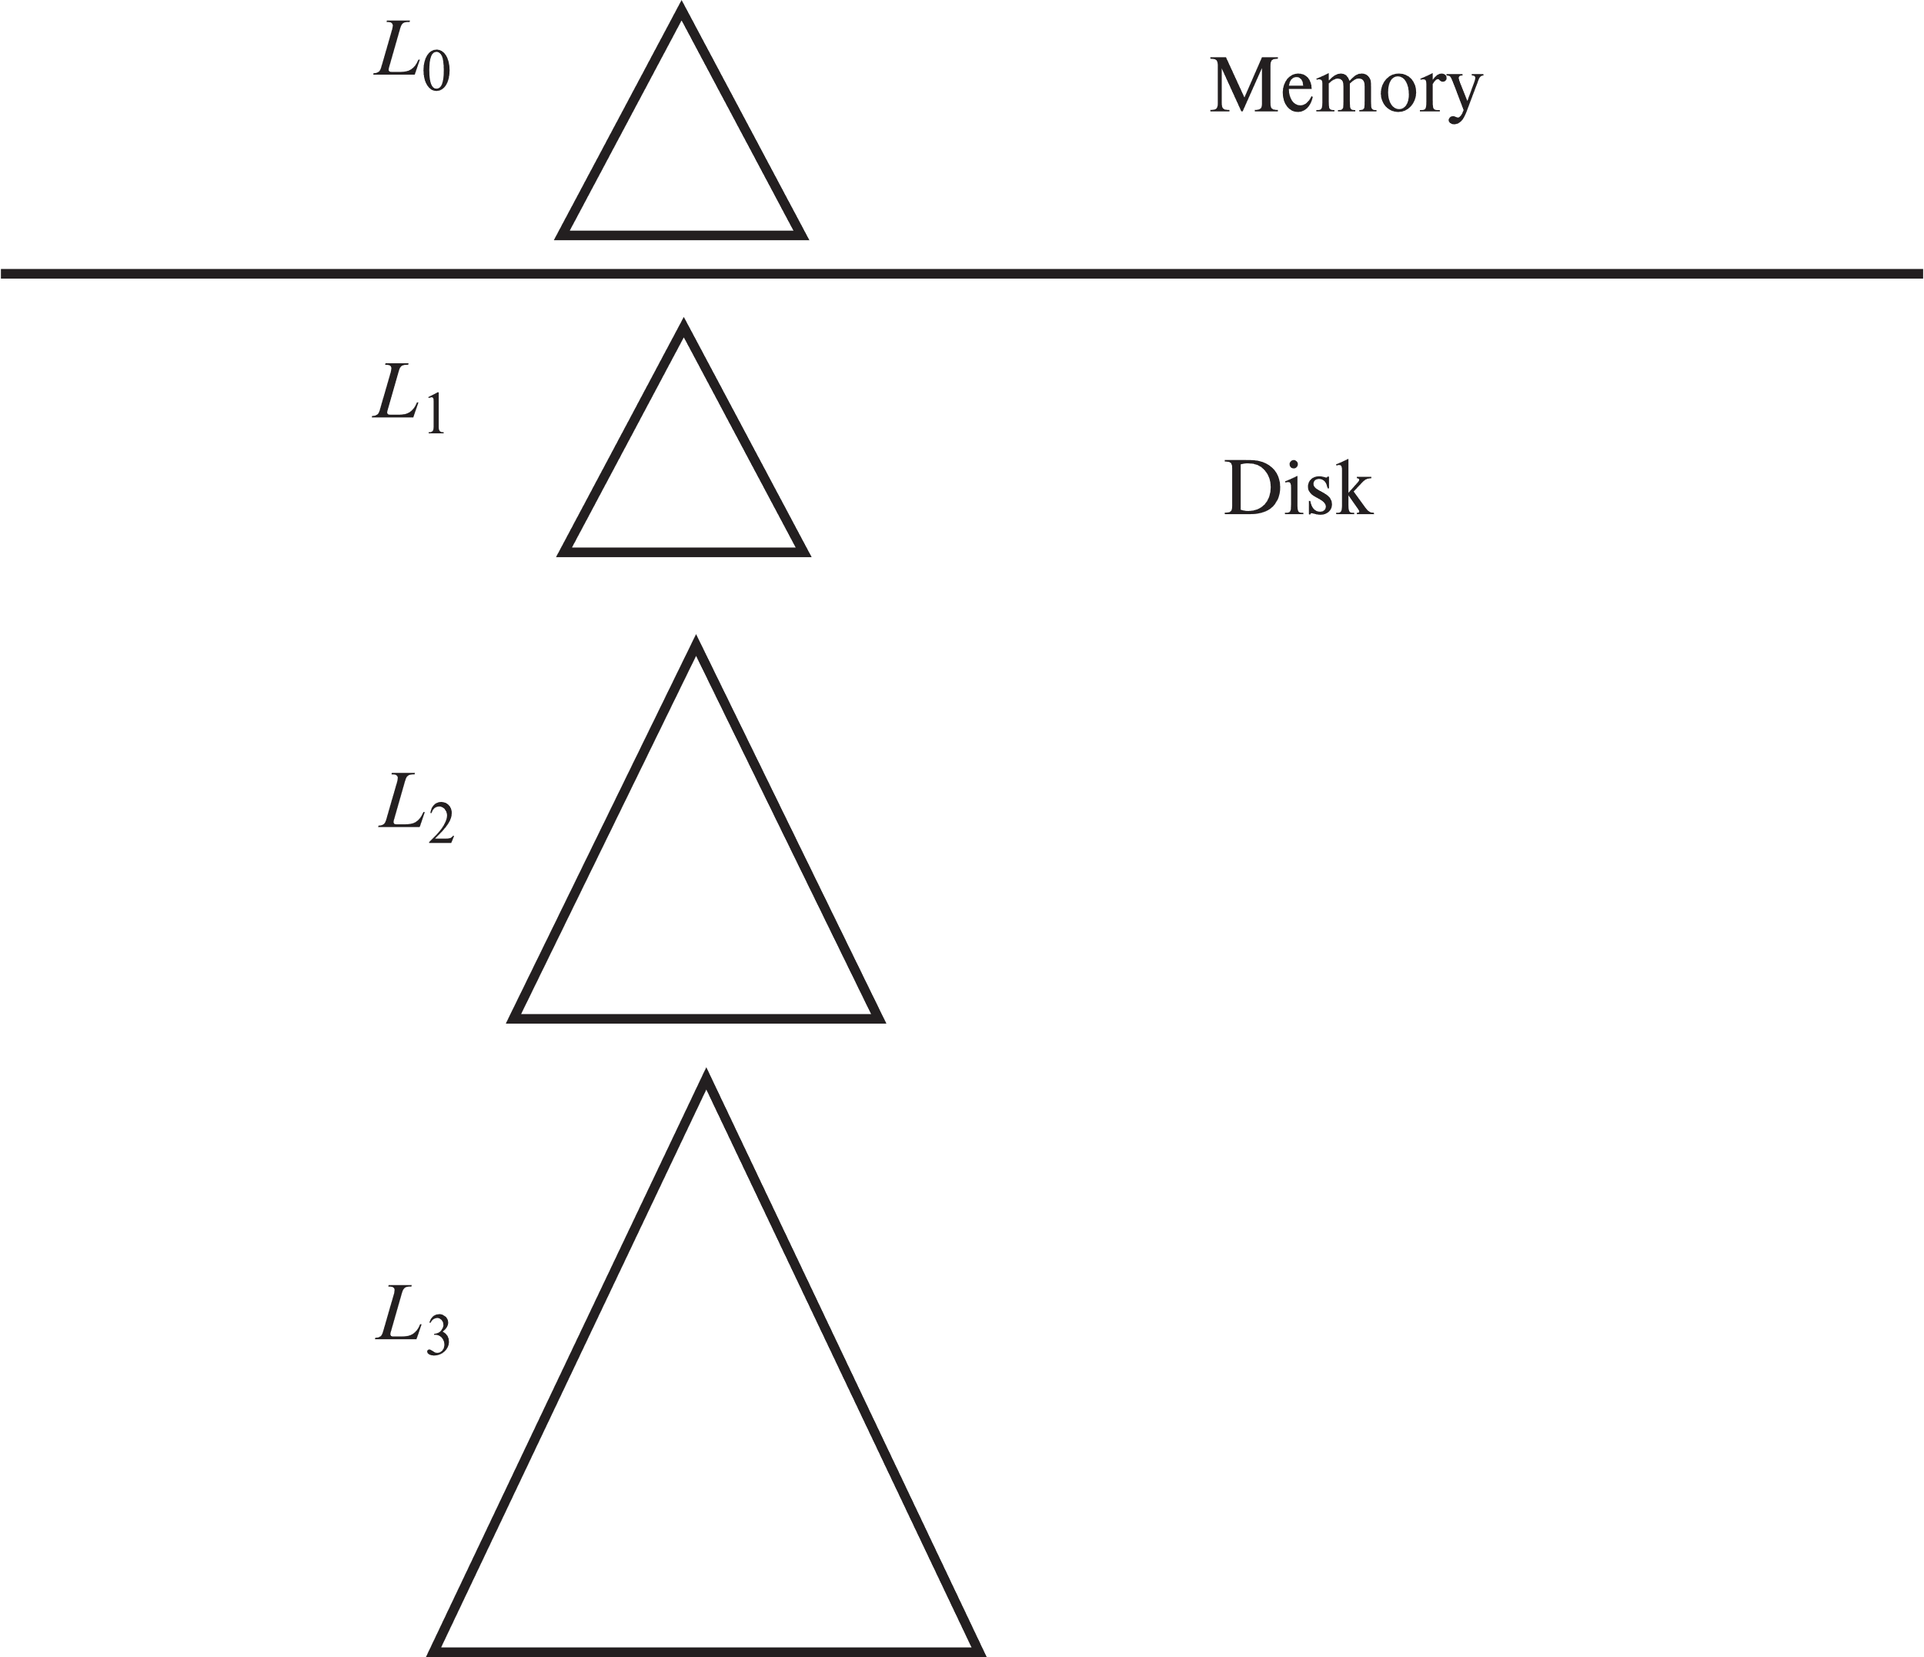
Log Structured Merge (LSM) Tree
Consider only inserts/queries for now
Records inserted first into in-memory tree (L₀ tree)
When in-memory tree is full, records moved to disk (L₁ tree)
  B⁺-tree constructed using bottom-up build by merging existing L₁ tree with records from L₀ tree
When L₁ tree exceeds some threshold, merge into L₂ tree
  And so on for more levels
  Size threshold for L_{i+1} tree is k times size threshold for L_{i} tree

Slide 58
LSM Tree (Cont.)
Benefits of LSM approach
  Inserts are done using only sequential I/O operations
  Leaves are full, avoiding space wastage
  Reduced number of I/O operations per record inserted as compared to normal B⁺-tree (up to some size)
Drawback of LSM approach
  Queries have to search multiple trees
  Entire content of each level copied multiple times
Stepped-merge index
  Variant of LSM tree with multiple trees at each level
  Reduces write cost compared to LSM tree
  But queries are even more expensive
    Bloom filters to avoid lookups in most trees
Details are covered in Chapter 24

Slide 59
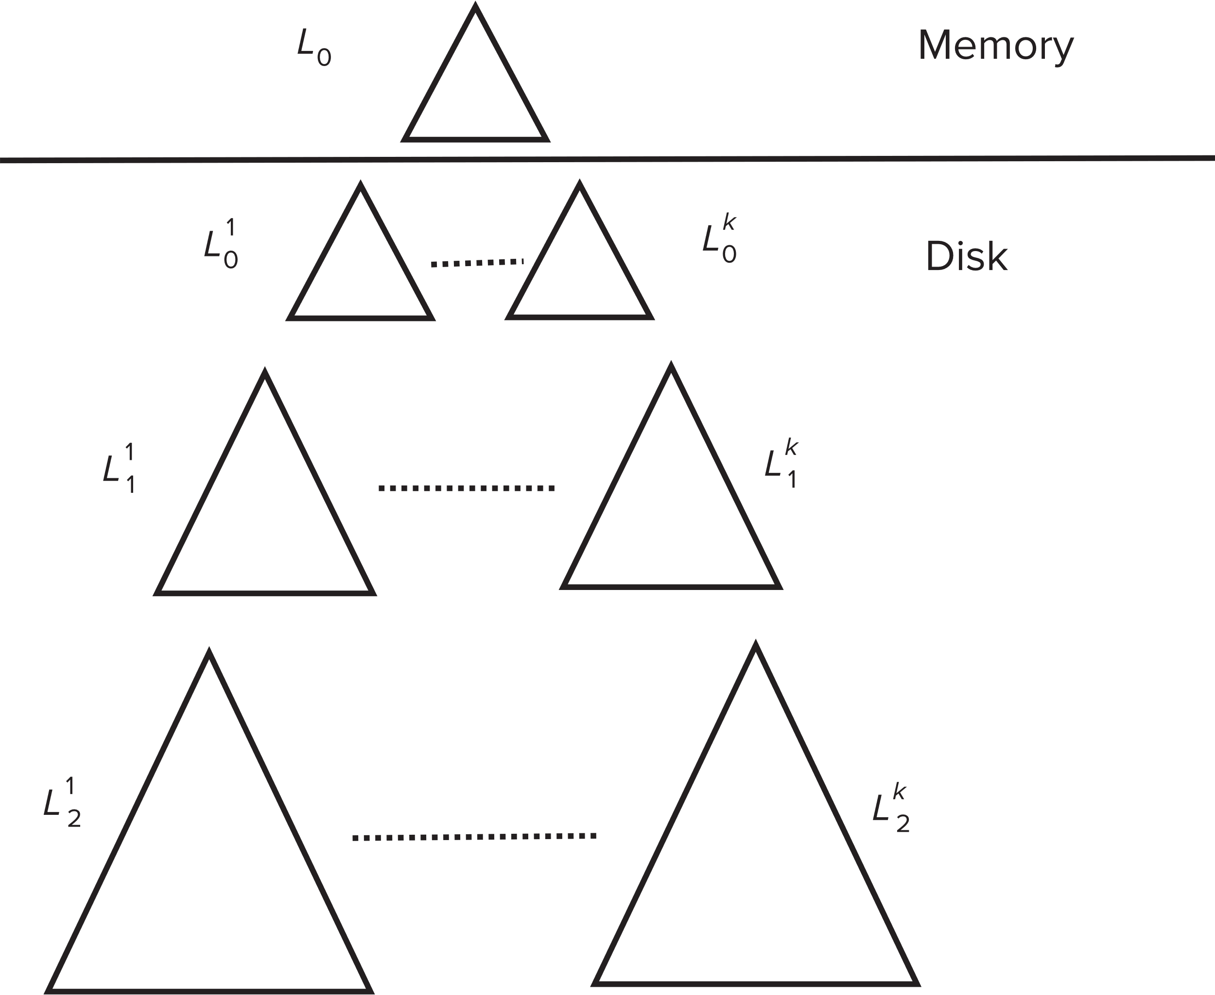
LSM Tree (Cont.) - Stepped Merge Index
Stepped-merge index: variant of LSM tree with k trees at each level on disk
  When all k indices exist at a level, merge them into one index of next level.
  Reduces write cost compared to LSM tree
But queries are even more expensive since many trees need to be queries
Optimization for point lookups
  Compute Bloom filter for each tree and store in-memory
  Query a tree only if Bloom filter returns a positive result

Slide 60
LSM Trees (Cont.)
Deletion handled by adding special “delete” entries
  Lookups will find both original entry and the delete entry, and must return only those entries that do not have matching delete entry
  When trees are merged, if we find a delete entry matching an original entry, both are dropped.
Update handled using insert+delete
LSM trees were introduced for disk-based indices
  But useful to minimize erases with flash-based indices
  The stepped-merge variant of LSM trees is used in many BigData storage systems
    Google BigTable, Apache Cassandra, MongoDB
    And more recently in SQLite4, LevelDB, and MyRocks storage engine of MySQL

Slide 61
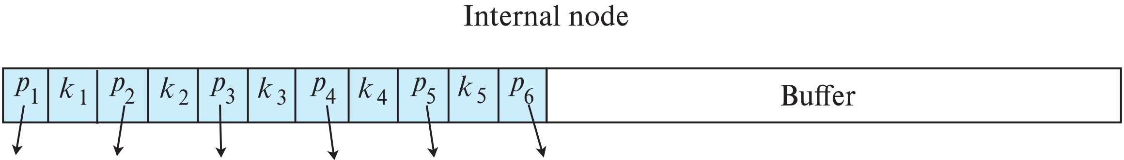
Buffer Tree
Key idea: each internal node of B⁺-tree has a buffer to store inserts
  Inserts are moved to lower levels when buffer is full
  With a large buffer, many records are moved to lower level each time
  Per record I/O decreases correspondingly
Benefits
  Less overhead on queries
  Can be used with any tree index structure
  Used in PostgreSQL Generalized Search Tree (GiST) indices
Drawback: more random I/O than LSM tree

Slide 62
Bitmap Indices
Bitmap indices are a special type of index designed for efficient querying on multiple keys
Records in a relation are assumed to be numbered sequentially from, say, 0
  Given a number n it must be easy to retrieve record n
    Particularly easy if records are of fixed size
Applicable on attributes that take on a relatively small number of distinct values
  E.g., gender, country, state, …
  E.g., income-level (income broken up into a small number of levels such as 0-9999, 10000-19999, 20000-50000, 50000- infinity)
A bitmap is simply an array of bits

Slide 63
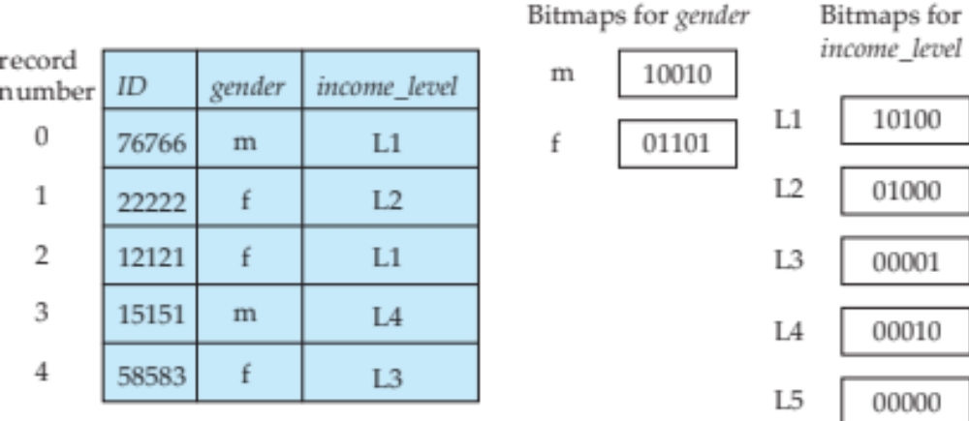
Bitmap Indices (Cont.)
In its simplest form a bitmap index on an attribute has a bitmap for each value of the attribute
  Bitmap has as many bits as records
  In a bitmap for value v, the bit for a record is 1 if the record has the value v for the attribute, and is 0 otherwise
Example

Slide 64
Bitmap Indices (Cont.)
Bitmap indices are useful for queries on multiple attributes
  not particularly useful for single attribute queries
Queries are answered using bitmap operations
  Intersection (and)
  Union (or)
Each operation takes two bitmaps of the same size and applies the operation on corresponding bits to get the result bitmap
  E.g., 100110 AND 110011 = 100010
  100110 OR 110011 = 110111
  NOT 100110 = 011001
  Males with income level L1: 10010 AND 10100 = 10000
    Can then retrieve required tuples.
    Counting number of matching tuples is even faster

Slide 65
Bitmap Indices (Cont.)
Bitmap indices generally very small compared with relation size
  E.g., if record is 100 bytes, space for a single bitmap is 1/800 of space used by relation.
    If number of distinct attribute values is 8, bitmap is only 1% of relation size

Slide 66
Efficient Implementation of Bitmap Operations
Bitmaps are packed into words; a single word and (a basic CPU instruction) computes and of 32 or 64 bits at once
  E.g., 1-million-bit maps can be and-ed with just 31,250 instruction
Counting number of 1s can be done fast by a trick:
  Use each byte to index into a precomputed array of 256 elements each storing the count of 1s in the binary representation
    Can use pairs of bytes to speed up further at a higher memory cost
  Add up the retrieved counts
0 | 1 | 2 | 3 | … | 253 | 254 | 255
0 | 1 | 1 | 2 |  | 6 | 6 | 7

Slide 67
End of Chapter 14

